Slide 1
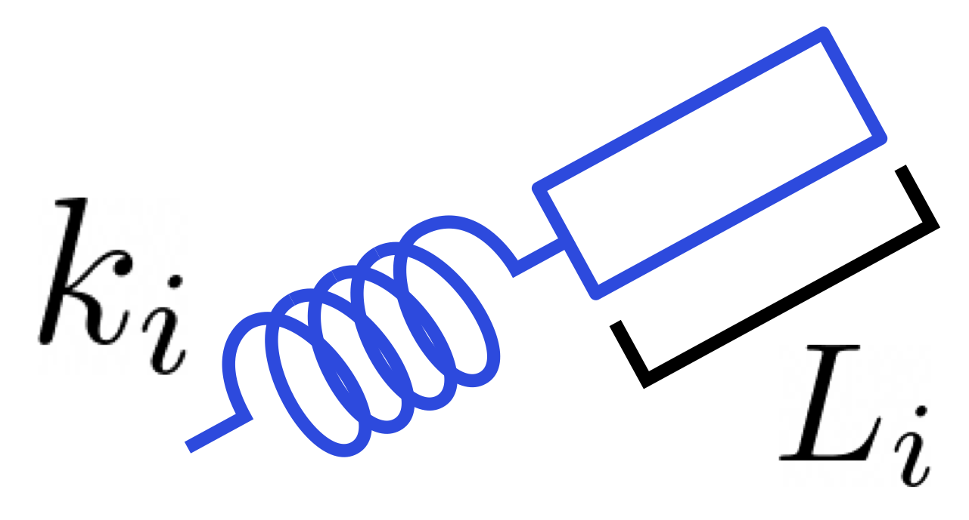

Tunable Elastic Materials that Self-Adjust via Local Learning Rules
Lauren Altman, Nachi Stern, Andrea Liu,
Doug Durian, Shivangi Misra, Cynthia Sung
Aspen Winter Conference 2024
arXiv:2311.00170

Slide 2
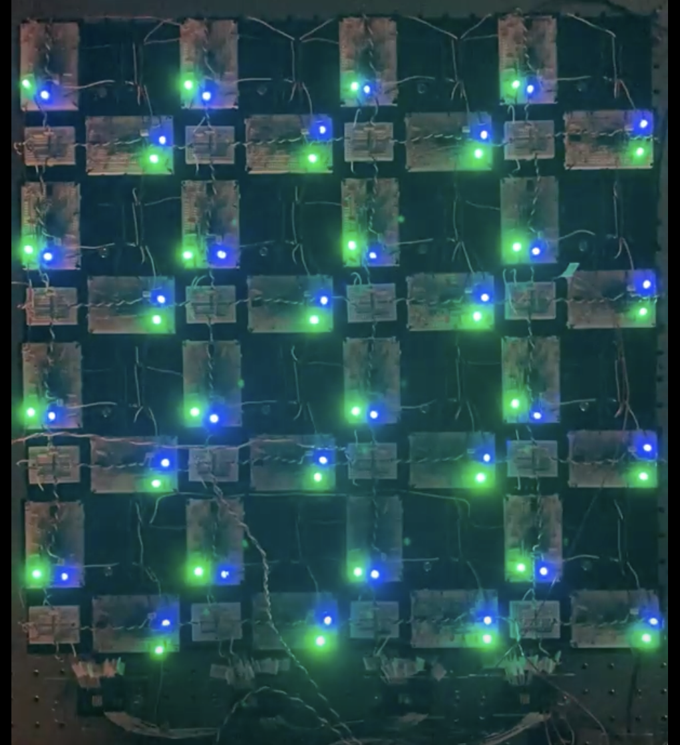
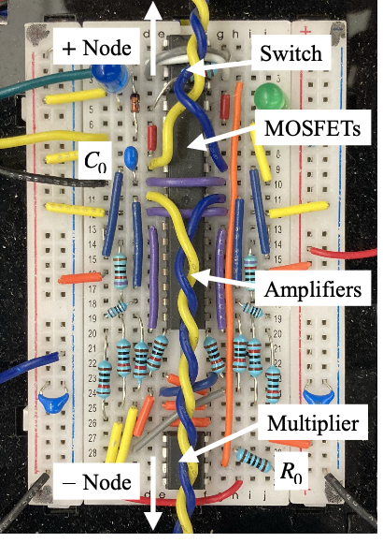
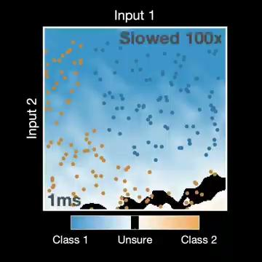
Variable Resistor Flow Networks
Dillavou, Beyer, Stern, Miskin, Liu, Durian
arXiv:2311.00537

Slide 3
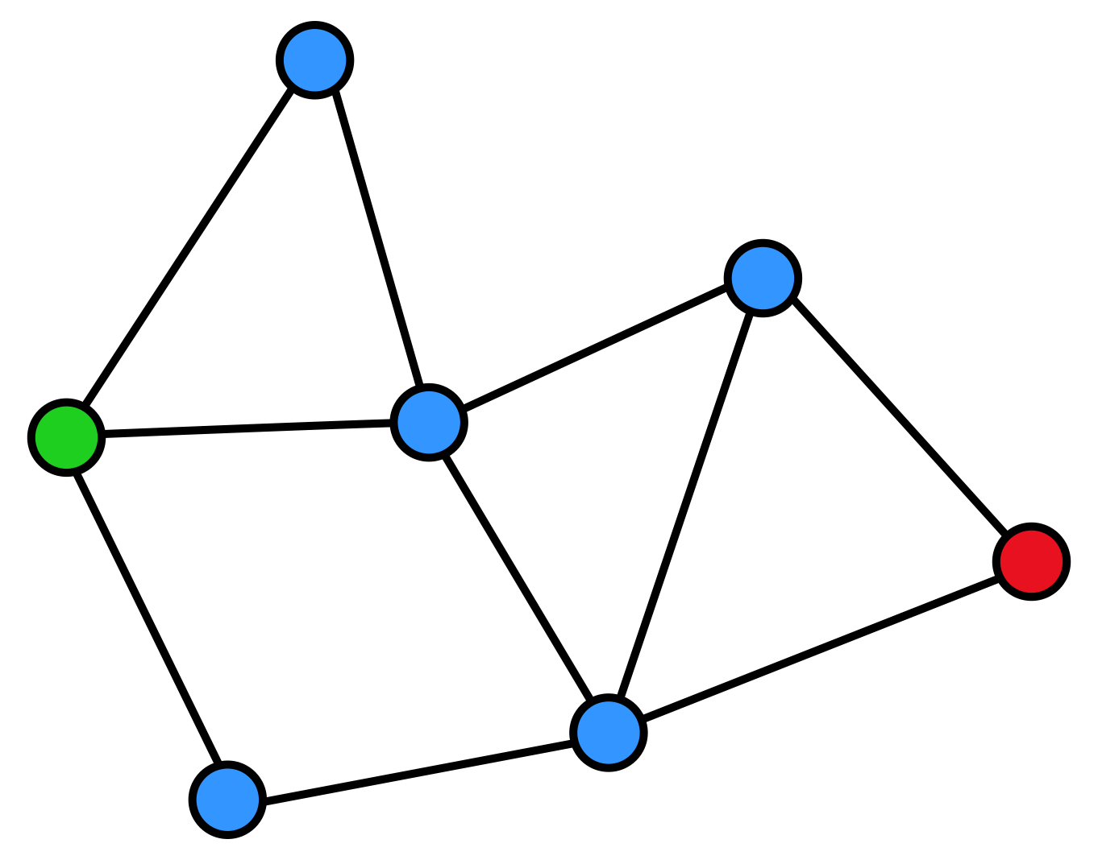
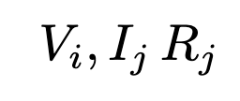
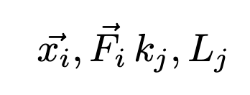
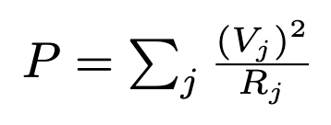
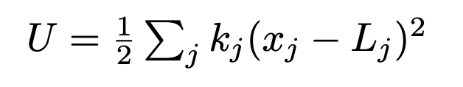
Coupled Learning: Circuits to Mechanical
Flow Network
Mechanical Network
Physical DOF
Learning DOF
Physical DOF
Learning DOF
Key Differences
Physical DoF are vectors not scalars -> nonlinear!
Network is spatially embedded -> hard to build a twin network!
Extra learning DoF (no analog to rest length)

Slide 4
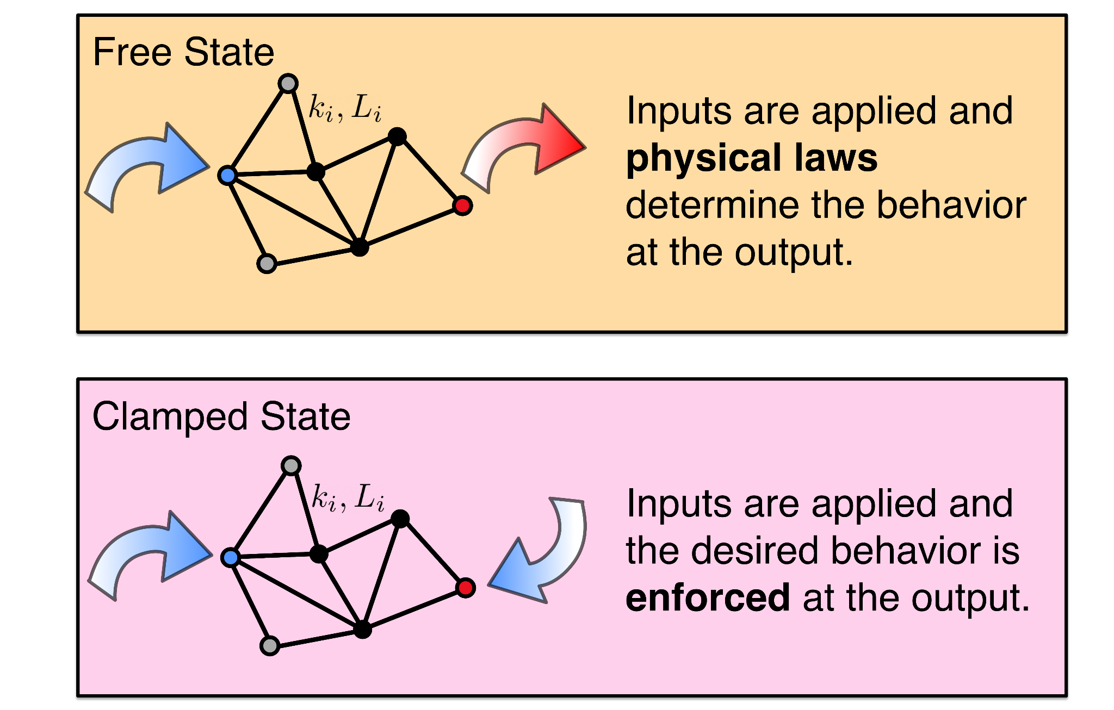
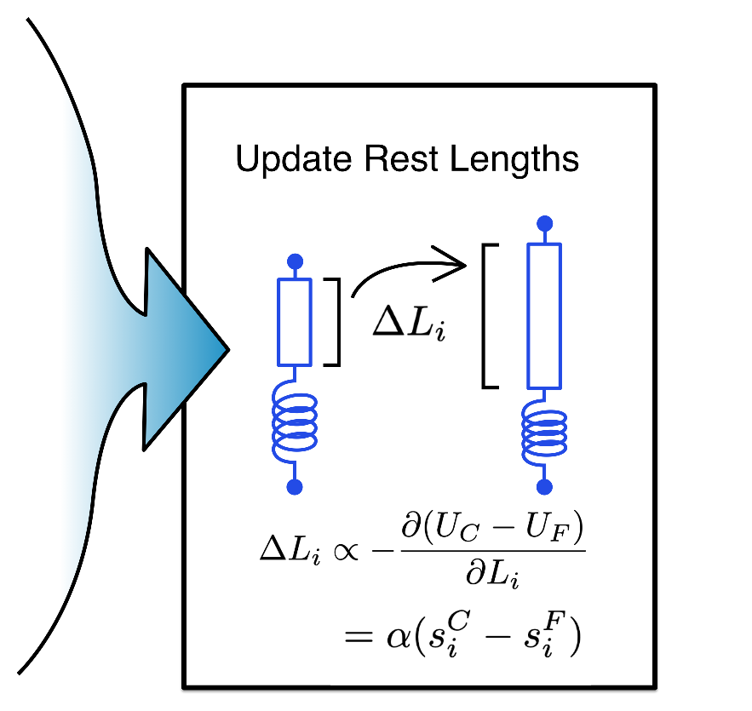
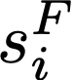
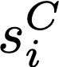
Coupled Learning
Local!
Notes:
Contrastive algorithm
Free state is “attempt/prediction”
Clamped state is “right answer/back of flashcard”

Slide 5
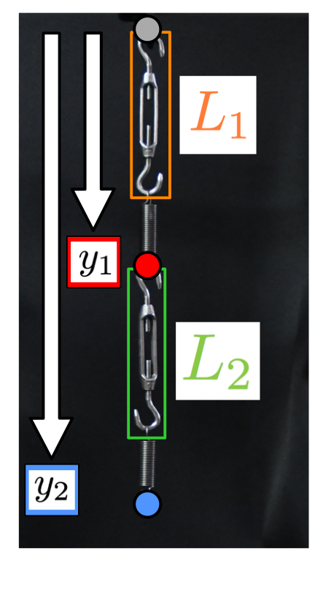
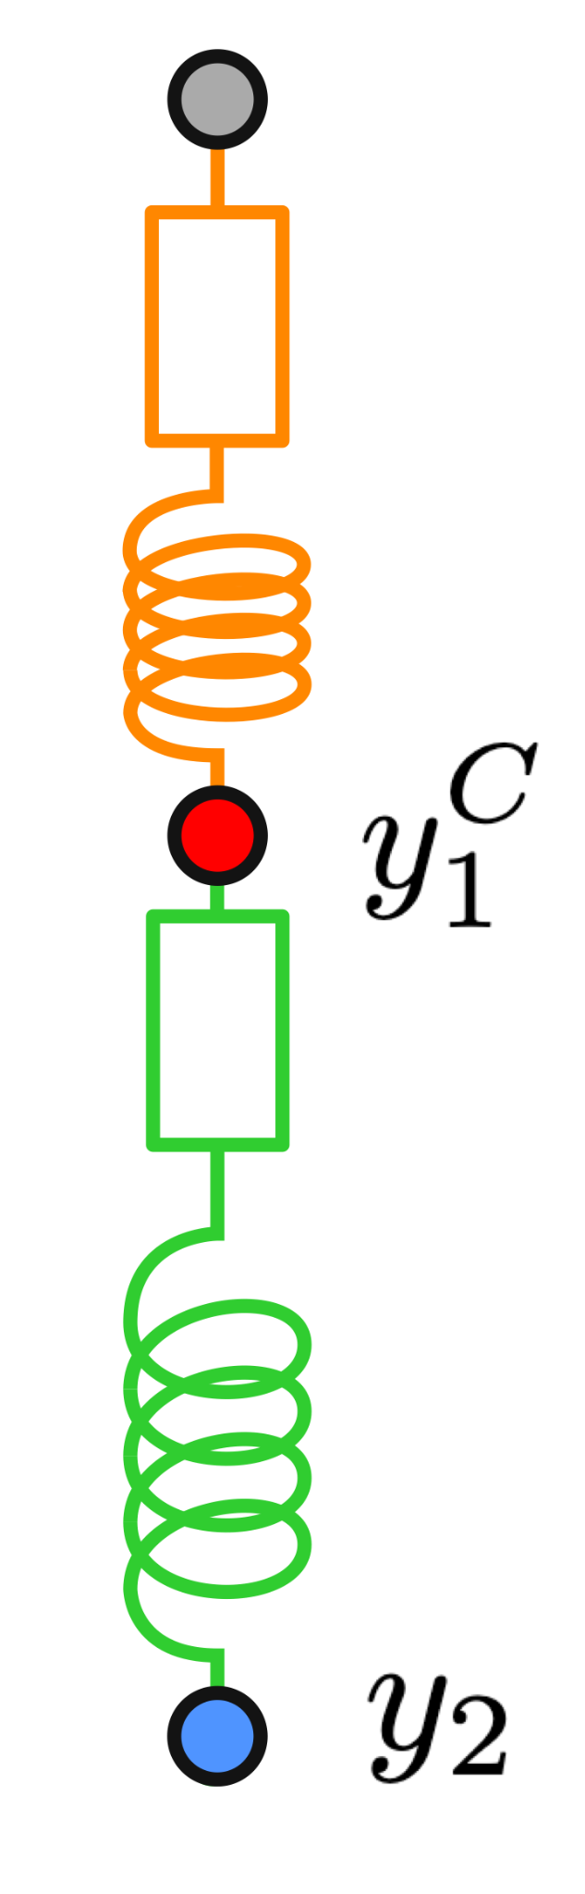
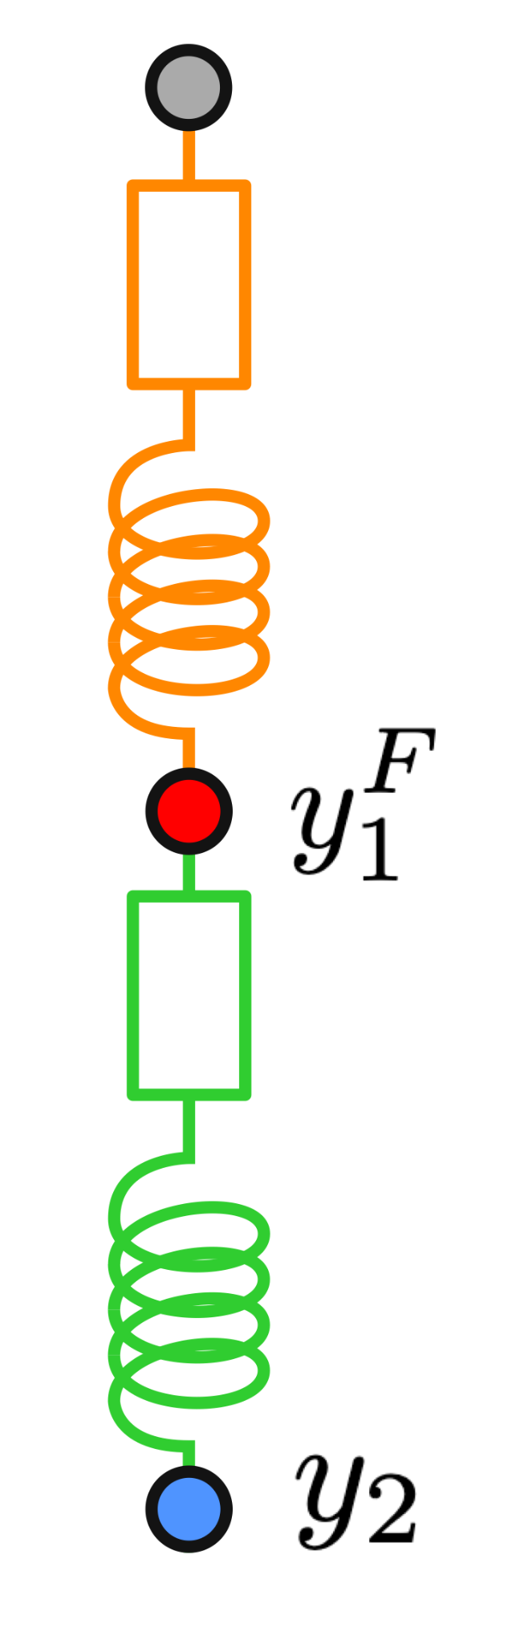
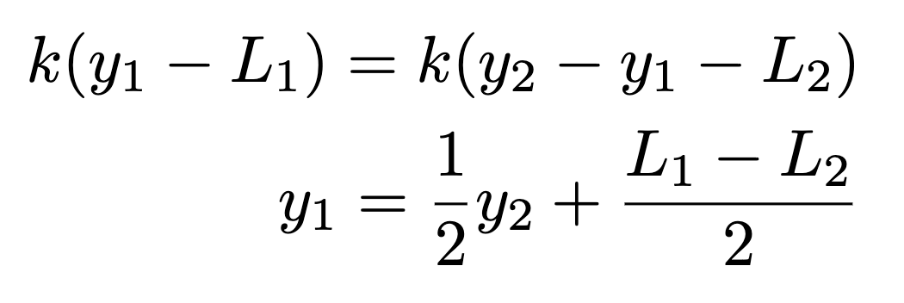
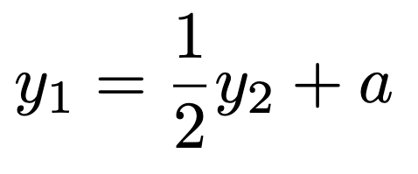
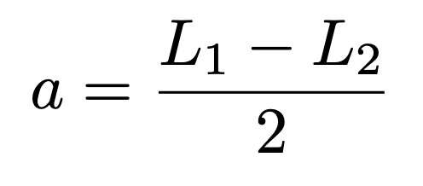
Learning on Rest Length:
Turnbuckles
Clamp
Free
EOM (Free state):
Train for:
Many solutions:

Slide 6
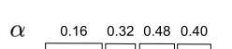
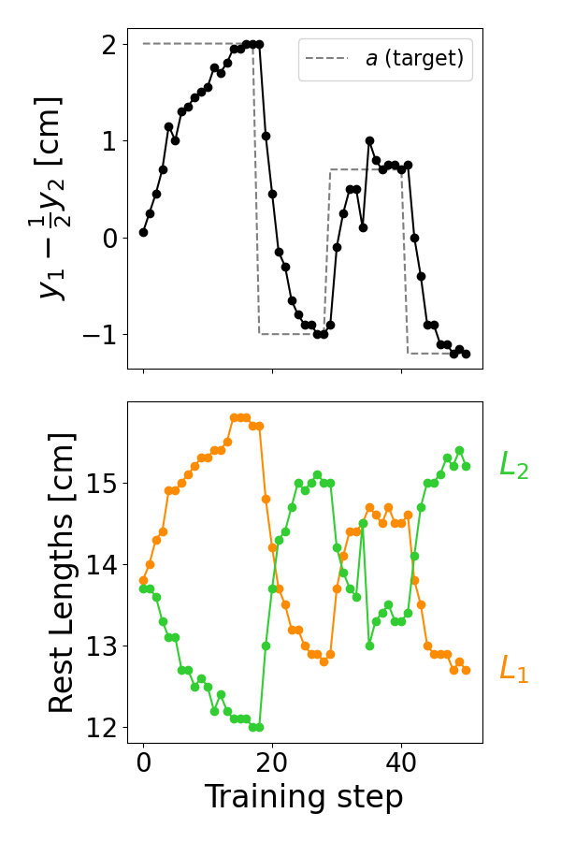
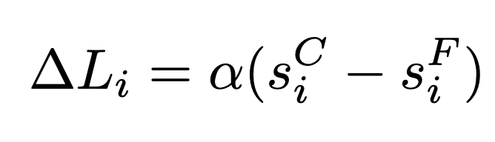
Training
Coupled Learning Update Rule
Learning rate
(dimensionless)
Spring extensions
Network learns four different tasks (a values) successively without resetting
Rest lengths evolve opposite to each other

Slide 7
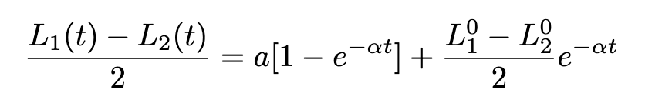
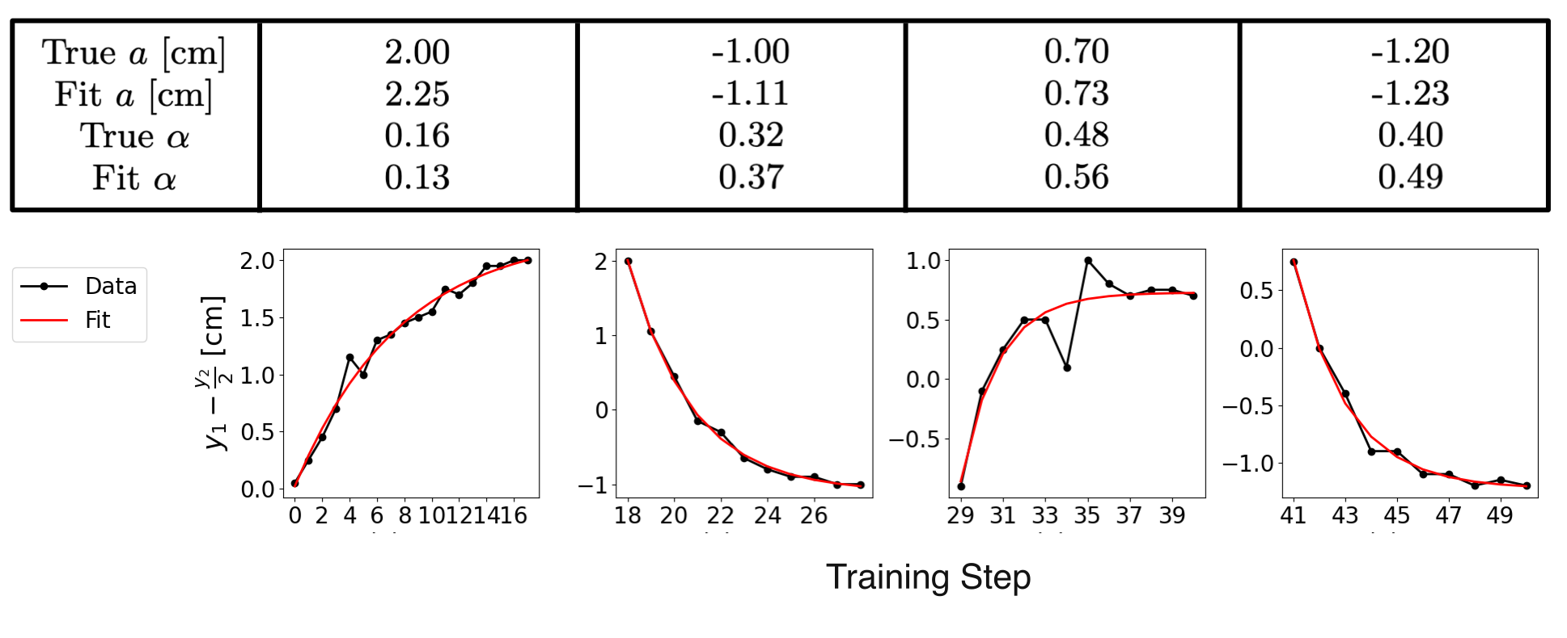
Learning Dynamics

Slide 8
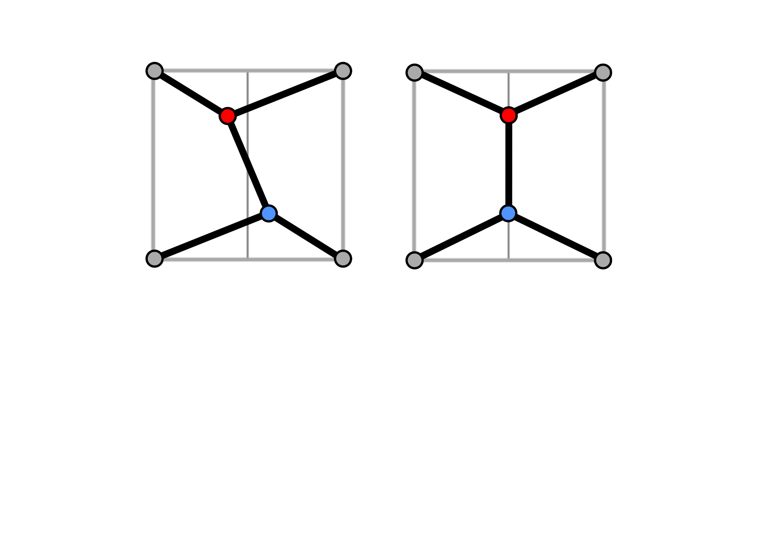
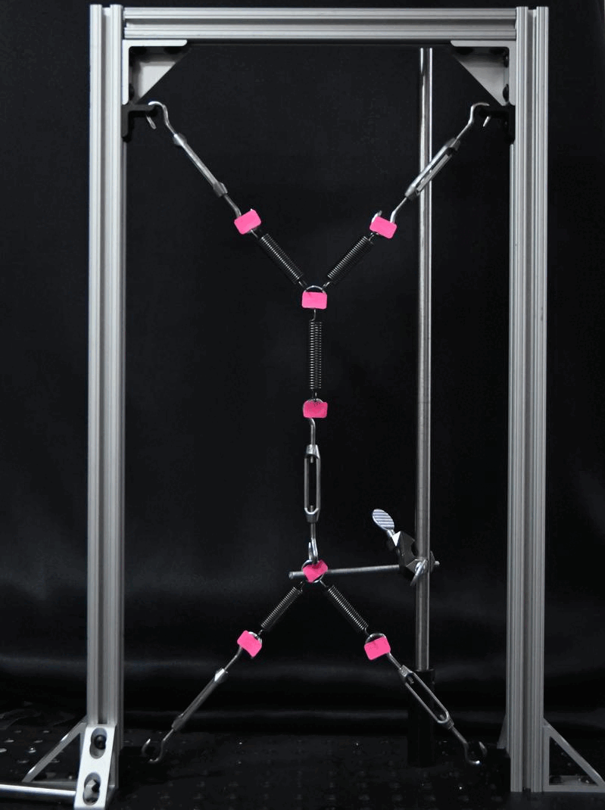
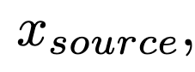
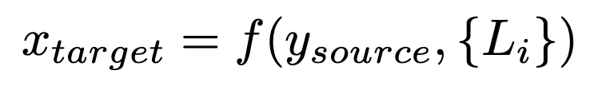
A 2D network: Training For Symmetry
Free State
Desired: Symmetric Network
(x,y)
(x,y)
Desired Behavior?
x, x = 0
for any value of y

Slide 9
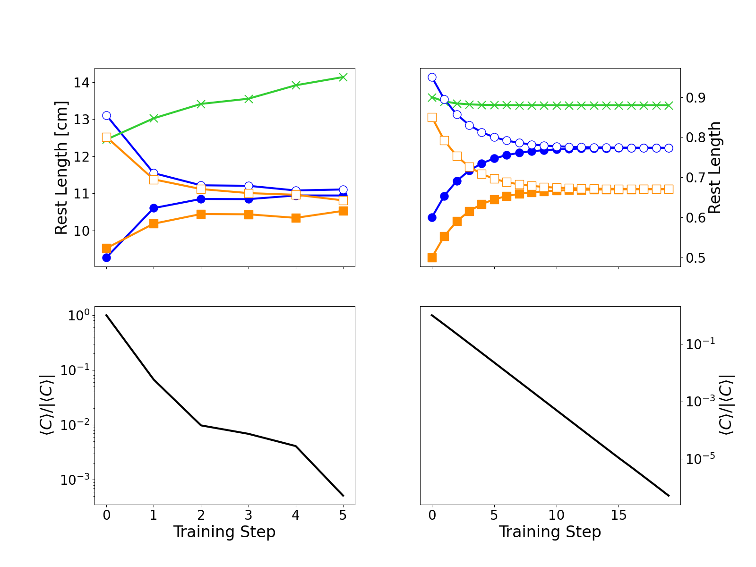
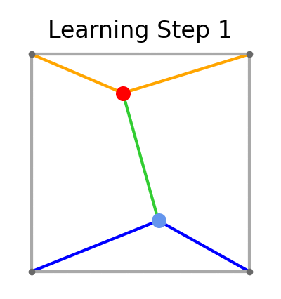
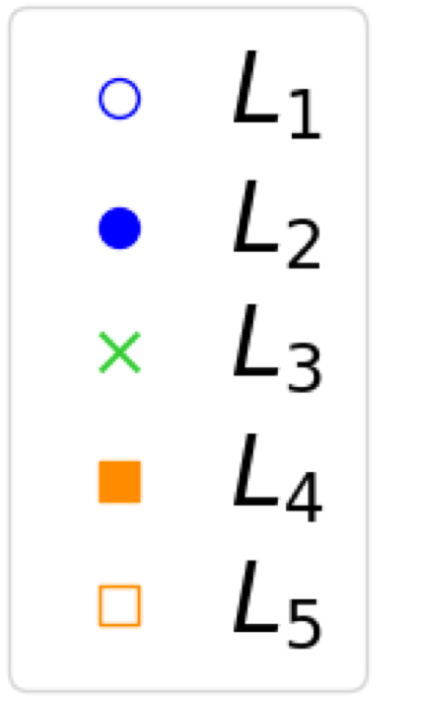
Training
Experiment
Simulation
Free State Evolution:

Slide 10
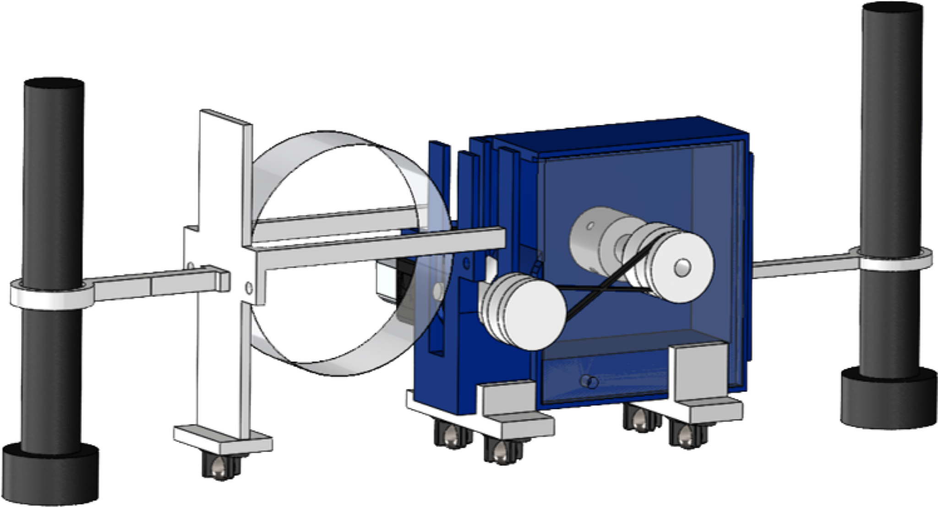
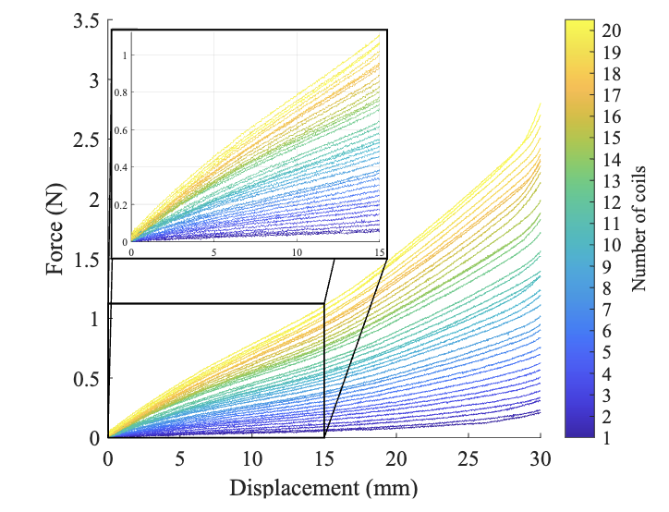
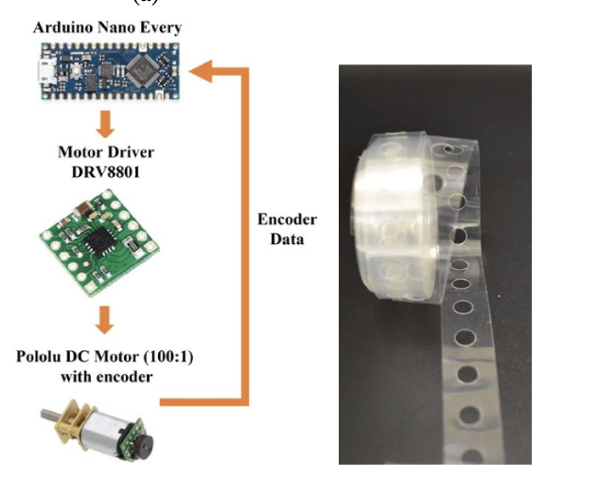
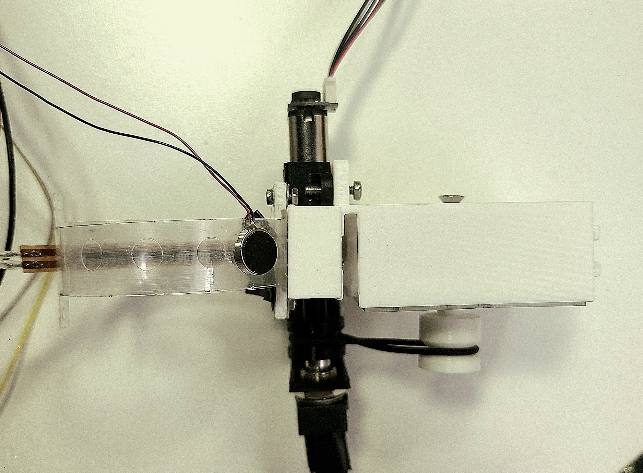
Learning on Stiffness: Coiled Spring Actuator
motor
Flex sensor
encoder
Stiffness range: (0.03 - 0.74)N/cm
Misra, S., Mitchell, M., Chen, R., & Sung, C. (2023). Design and Control of a Tunable-Stiffness Coiled-Spring Actuator.

Slide 11
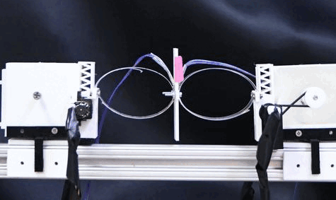
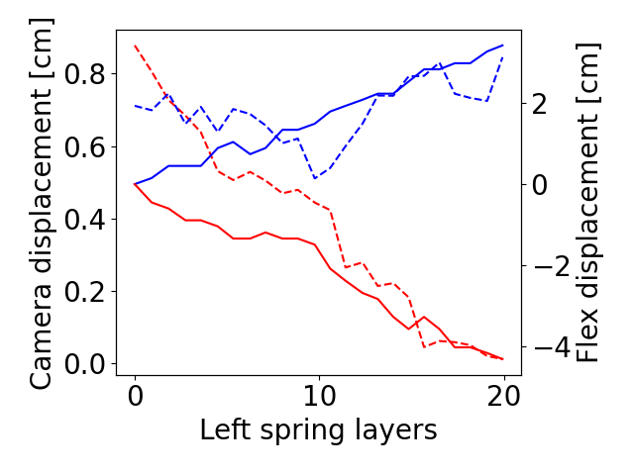
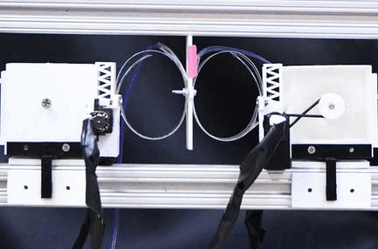
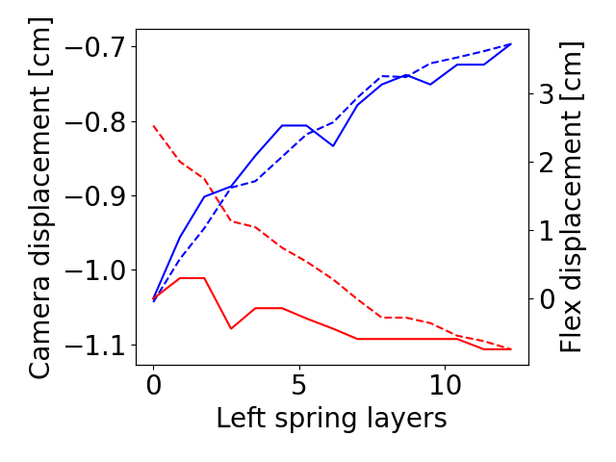
Extension
1
2
Compression
1
2

Slide 12
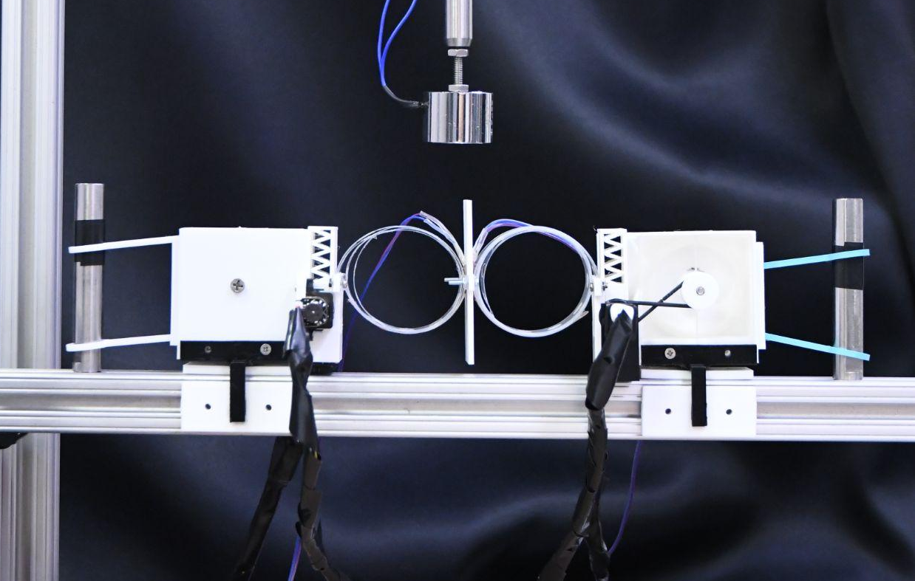
Tunable stiffness motion divider
External nodes held fixed
Electromagnet for clamping
External tracking for validation measurements
Springs restricted to 1d motion

Slide 13
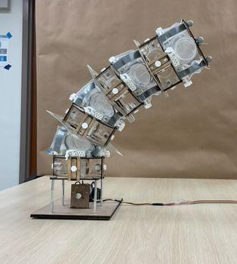
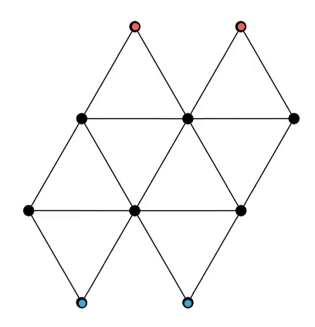
Future Work
Robotic Actuator Tower
Edge Allostery
Others?
Dynamical Behavior
Material properties
Not autonomous/motorized
Shivangi Misra

Slide 14


Thank you! Questions?
Posters:
Sam Dillavou
Nachi Stern
Marcelo Guzman
Collaborators:
Shivangi Misra
Maggie Miller
Nachi Stern
Jovana Andrejevic
Doug Durian
Andrea Liu
Cynthia Sung
arXiv:2311.00170

